Slide 1
CardioBeat AI: Heart Sound Classification with Deep Learning
By:
Hemil Shah
Niharika Das

Slide 2
Contents
1. The Problem
2. About the Dataset
3. Process Funnel
4. Solution Features
5. Impact of the Solution
6. Stand- Out Areas
7. Architecture Diagram
8. Interface Preview
i.) User Side Interface
ii.) Admin Side Interface
9. Future Scope
10. Thank You

Slide 3
Part-01: Introduction to Heart Sound Analysis

Slide 4
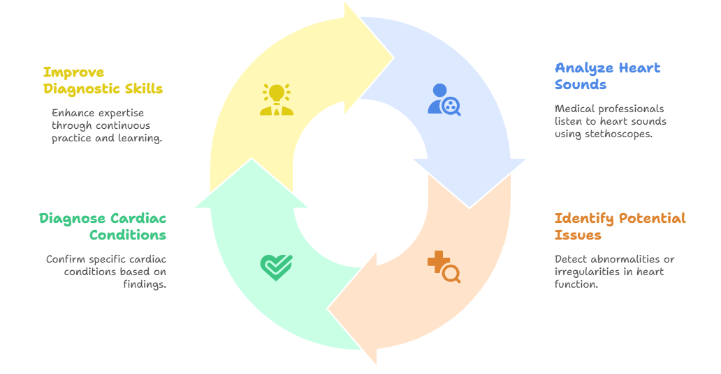
Diagnosing with Heart Sounds
Traditional Methods:
Analyzing heart sounds is key in diagnosing cardiac conditions, heavily relying on the expertise of medical professionals using stethoscopes.

Slide 5
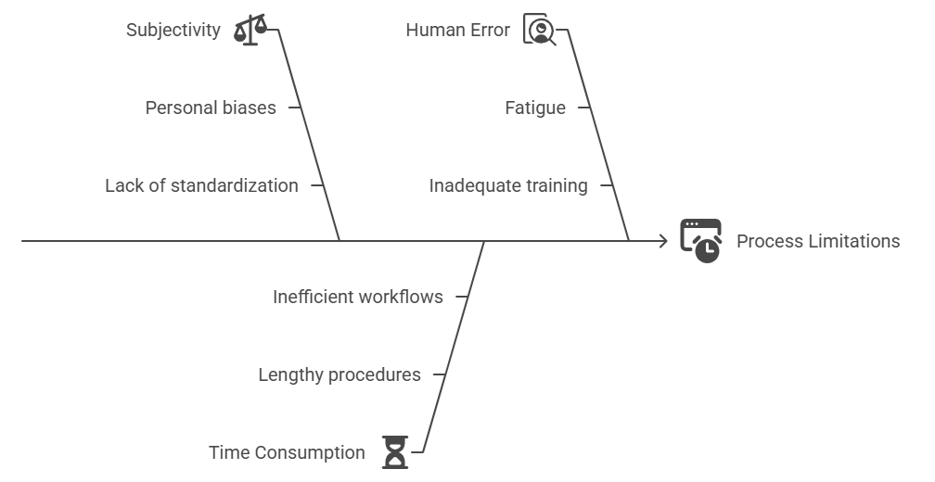
Diagnosing with Heart Sounds
The Challenges:
This process is subjective, requires time, and is prone to human error, presenting limitations. We aim to address.

Slide 6
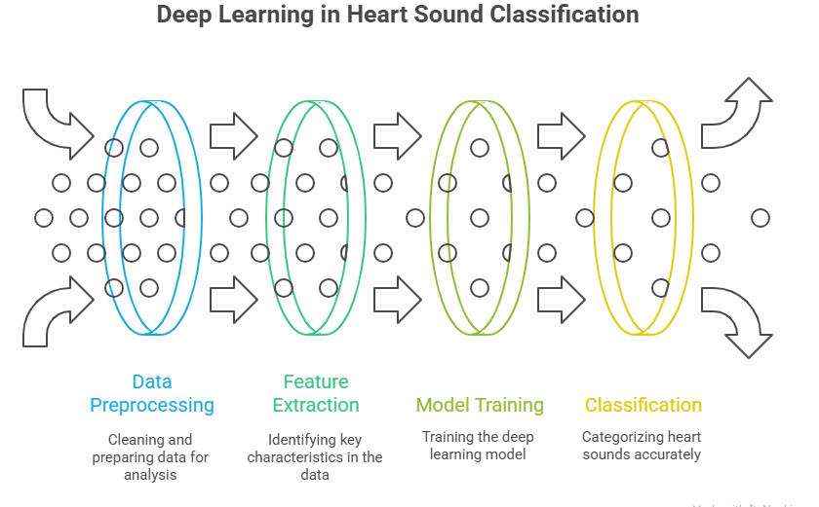
Diagnosing with Heart Sounds
Modern Solution:
Deep learning automates heart sound classification, providing a potent tool for preliminary diagnosis, improving efficiency and accuracy.

Slide 7
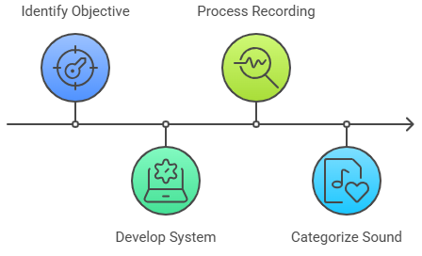
The Problem: Diagnosing Heart Sounds
Our Goal:
To build an end-to-end system that can take a heart sound recording and accurately classify it into one of several predefined categories.

Slide 8
Part-02: Dataset Overview

Slide 9
About the Dataset
Data Source:
The heart sound data is provided as a compressed RP1Heart Data final.zip file, encompassing a collection of heart sound recordings for analysis.
Structure:
The project utilizes a dataset of heart sounds that's provided as a compressed RP1Heart Data final.zip file. The application is designed to automatically unzip this file and organize the audio into distinct folders. Each folder represents a specific class, allowing the model to be trained on labeled data.
The model is trained on five specific categories of heart sounds:
AS (Aortic Stenosis)
MR (Mitral Regurgitation)
MS (Mitral Stenosis)
MVP (Mitral Valve Prolapse)
N (Normal)
The system then processes the individual audio files within these folders, extracting the necessary features to train the deep learning model.

Slide 10
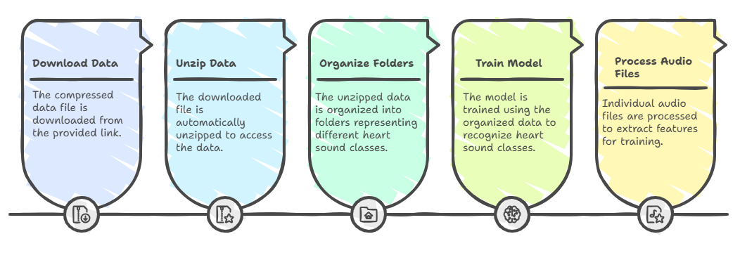
The Data Processing Sequence

Slide 11
Part-03: The Process Funnel: Sound to Diagnosis

Slide 12
Process Funnel
Raw Audio Input
It all begins when a user uploads a heart sound recording in formats like WAV, MP3, or MP4.
Audio Preprocessing & Feature Extraction
The raw audio is first cleaned by trimming out silent sections.
The file is then processed to a standardized format, and the key features are extracted. Our model uses Mel-spectrograms, which are visual representations of the audio's frequency and time.
Deep Learning Model
The Mel-spectrogram is fed into our pre-trained Convolutional Neural Network (CNN).
The CNN analyzes the image-like data to find patterns it learned during training.
Final Prediction
The model outputs a prediction of the heart sound's class.
The app displays the result with a confidence score and a breakdown of the probabilities for each category, giving you clear insights into the classification.

Slide 13
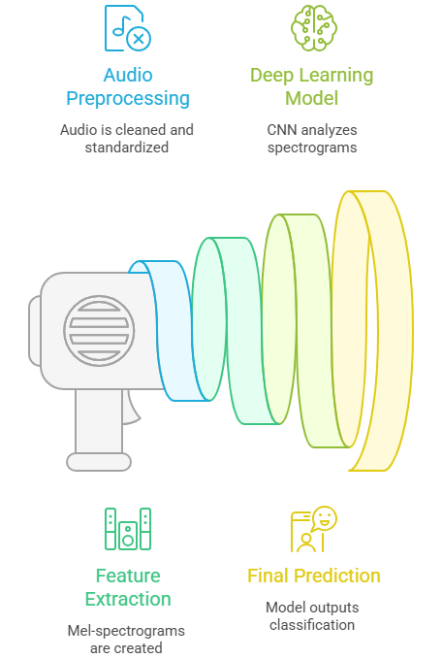
Process Funnel

Slide 14
Part-04: Solution Features:
CardioBeat: A User-Friendly System

Slide 15
Features:
A Comprehensive & User-Friendly System:
Navigation through this system is very easy. The process is very easy, and the user can perform the predictions very easily, on a very good looking UI.
Seamless Data Pipeline:
The application automates the entire process, from unzipping the raw data to training the model, making it a self-contained system.
Deep Learning at the Core:
Utilizes a custom-built, multi-layered Convolutional Neural Network (CNN), specifically designed to classify complex audio patterns with high accuracy.
Feature Engineering:
Transforms raw audio signals into Mel-spectrograms , converting time-series data into a visual format that the CNN can analyze effectively.

Slide 16
Features:
Interactive Streamlit UI:
Features a simple, elegant web interface that allows users to easily upload audio files and receive instant predictions.
Multi-Format Support:
Goes beyond basic WAV files by supporting MP3 and MP4 formats, thanks to the integration of the pydub library.
Intuitive Visualizations:
Provides clear visual feedback by displaying both the audio waveform and the Mel-spectrogram of the uploaded file.
Actionable Predictions:
Presents the classification result with a confidence score and a detailed probability breakdown for all categories, offering valuable insights beyond a simple label.

Slide 17
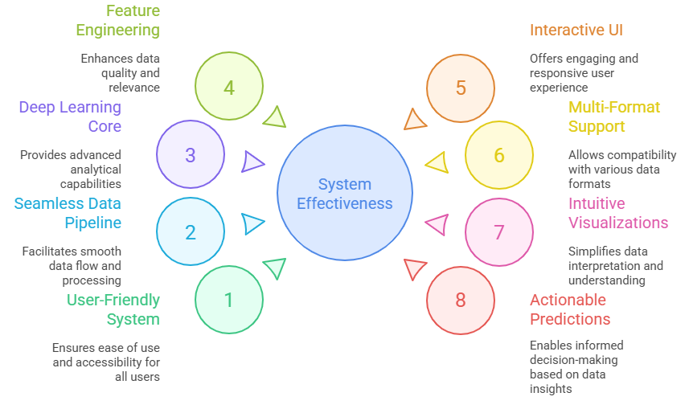
Features:

Slide 18
Part-05: Impact of the Solution: Transforming Diagnostics

Slide 19
Impact:
Democratized Access to Diagnostics:
Our solution provides a low-cost, accessible tool for preliminary heart sound analysis. This can be particularly impactful in areas with limited access to specialized medical equipment or professionals.
Empowering Users:
The application doesn't just give a diagnosis; it offers clear visualizations of the heart sound's waveform and Mel-spectrogram. This helps users understand the data and provides valuable educational insight into the analysis process.
Preliminary Screening & Triage:
While not a replacement for professional medical advice, the app can serve as a valuable initial screening tool. It could help flag potential issues, encouraging users to seek a formal diagnosis from a doctor.
Bridging Technology & Medicine:
The project demonstrates how cutting-edge deep learning techniques can be applied to real-world medical challenges, paving the way for more AI-powered diagnostic tools in the future.

Slide 20
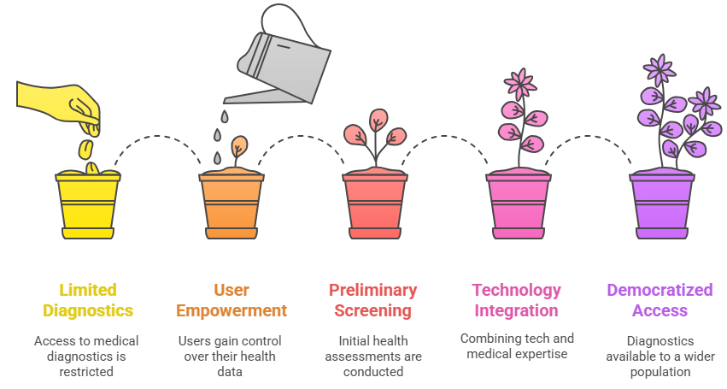
Impact:

Slide 21
Part-06: Stand-Out Areas: Innovative and Accessible

Slide 22
Stand-Out Areas:
Broad Accessibility:
Unlike traditional medical devices, this is a web-based, portable solution that can be used on a smartphone, tablet, or computer, making preliminary heart sound analysis available to a wider audience.
Empowering Visuals:
The application goes beyond a simple prediction by providing live visualizations of the sound wave and Mel-spectrogram. This not only makes the process transparent but also helps in understanding the underlying data.
Real-World Utility:
This project is a practical demonstration of how a sophisticated deep learning model can be deployed in a user-friendly application to address a real-world need, serving as a powerful proof of concept for future AI in medicine.
Flexible Input:
By supporting a variety of audio and video formats, including MP3 and MP4, the solution is adaptable and easy to use, avoiding the need for manual file conversion.

Slide 23
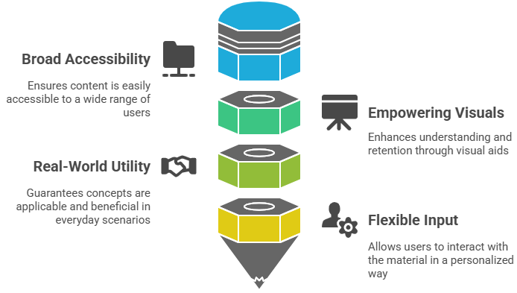
Stand-Out Areas:

Slide 24
Part-07: Architecture Diagram

Slide 25
Details: Architecture Diagram
The system's architecture can be visualized as a straightforward, linear pipeline.
Audio Input:
The user uploads a heart sound file (.wav, .mp3, .mp4) via the Streamlit interface.
Preprocessing & Feature Extraction:
The audio is loaded using librosa and converted to a standardized format. Mel-spectrogram features are then extracted, transforming the raw sound data into a dense, visual representation that the model can interpret.
Inference (Prediction):
The preprocessed features are fed into the trained Convolutional Neural Network (CNN), which analyzes the Mel-spectrogram to predict the heart sound's class.
Prediction Output:
The result is displayed to the user on the Streamlit dashboard. It includes the predicted class, the confidence score, and a breakdown of the probabilities for each class.

Slide 26
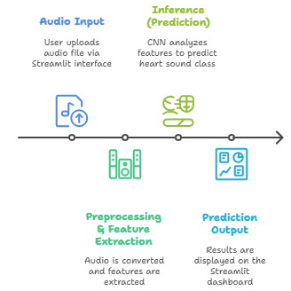
Heart Sound Analysis Pipeline:

Slide 27
Part-08: Interface Preview

Slide 28
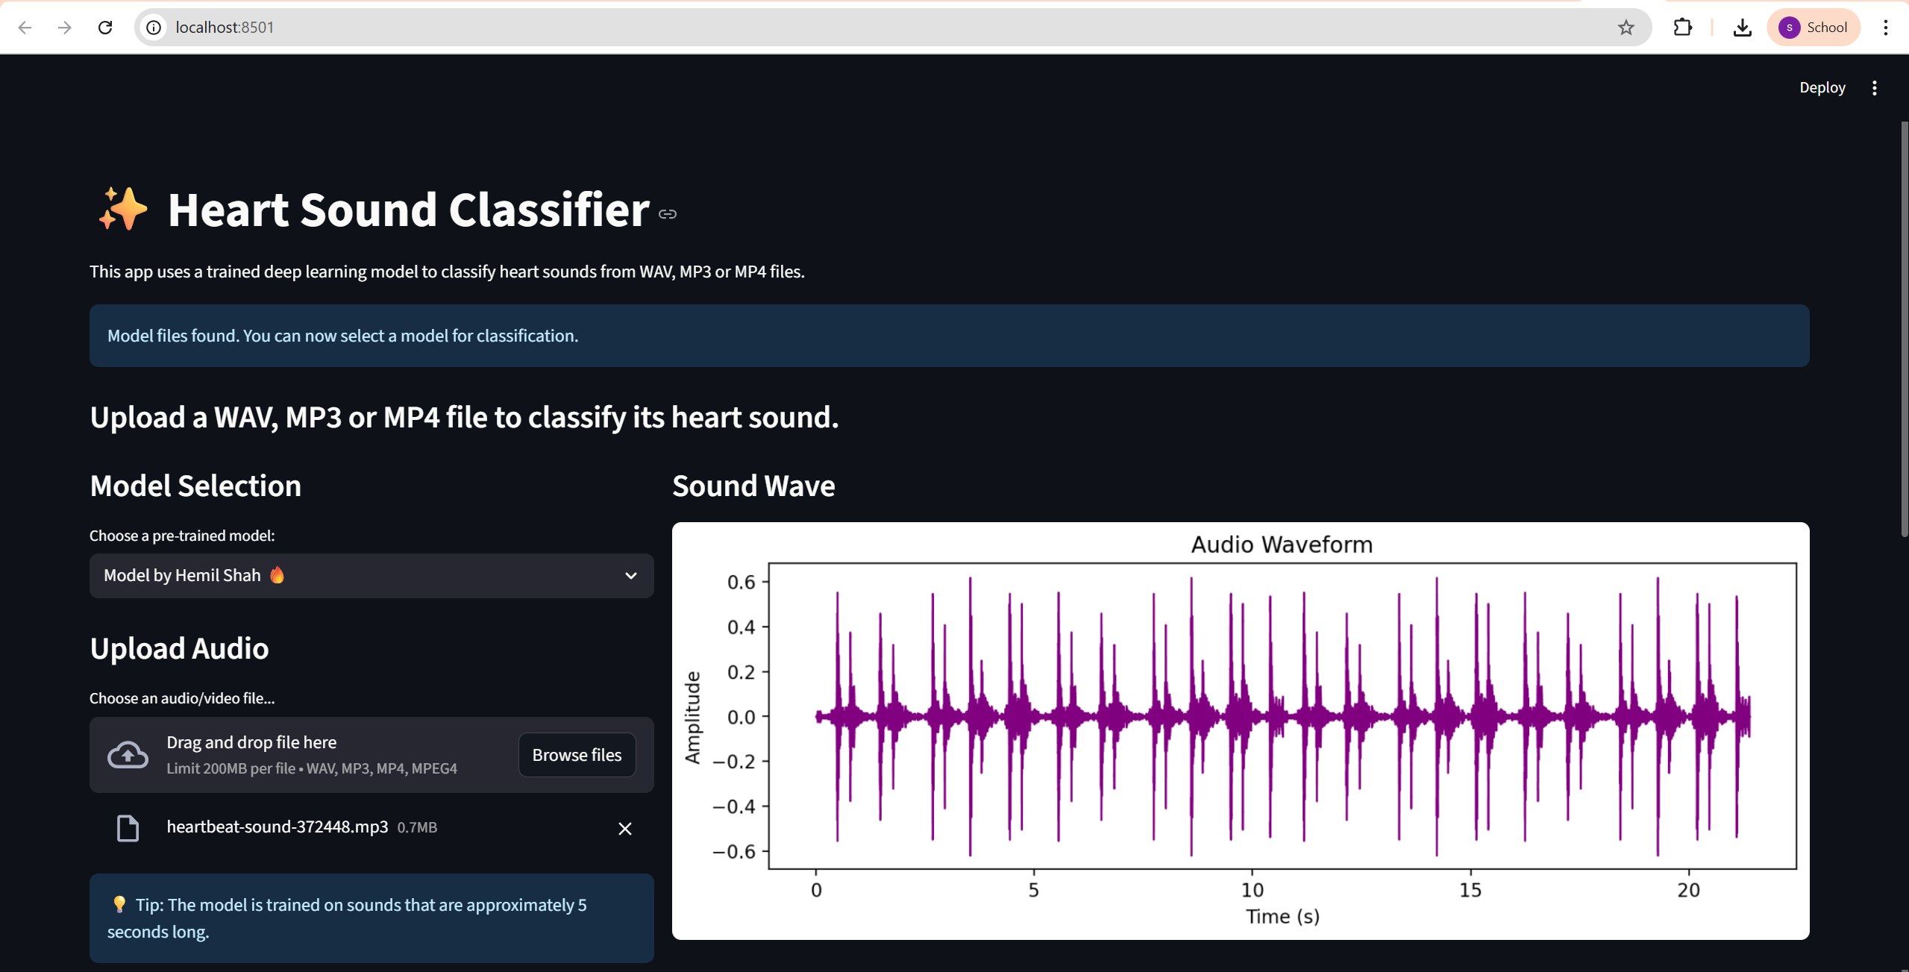
User-Side Interface

Slide 29
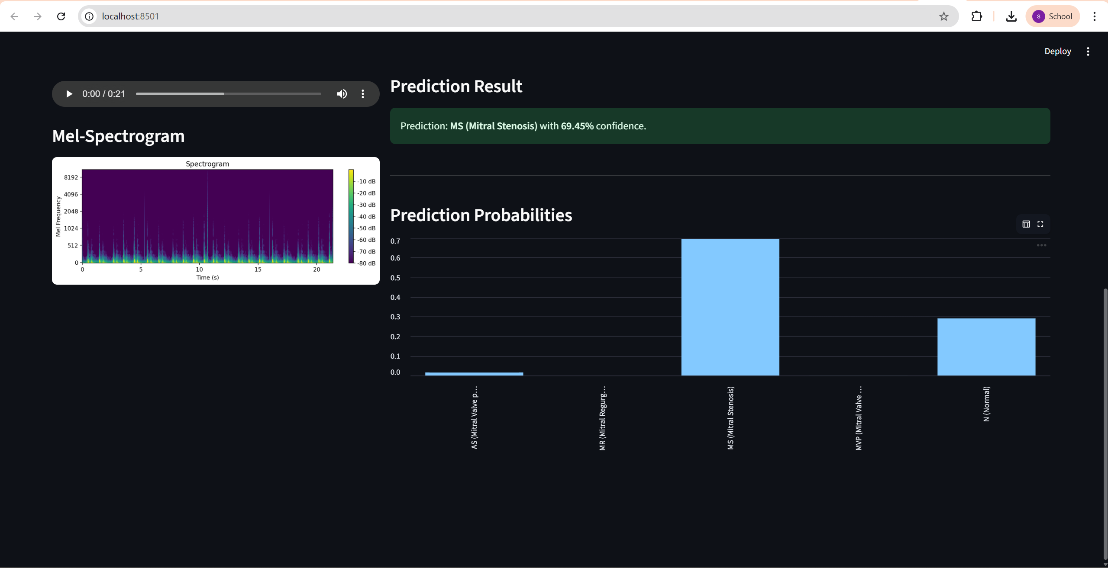
User-Side Interface

Slide 30
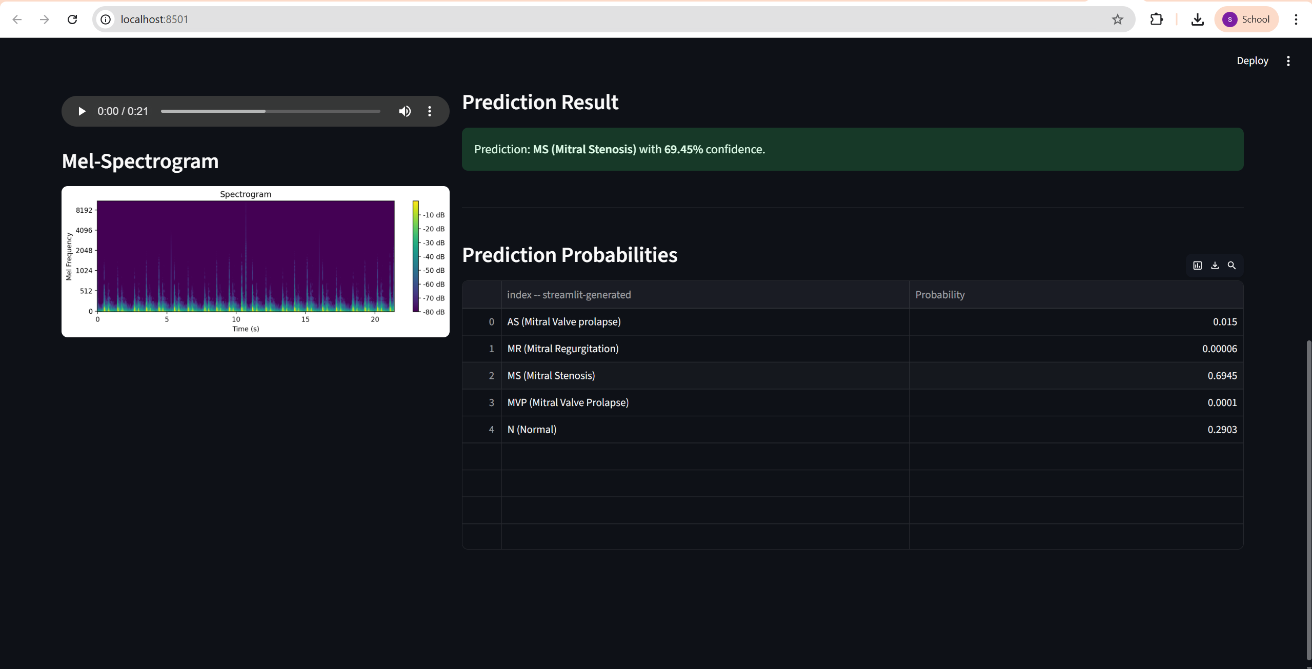
User-Side Interface

Slide 31
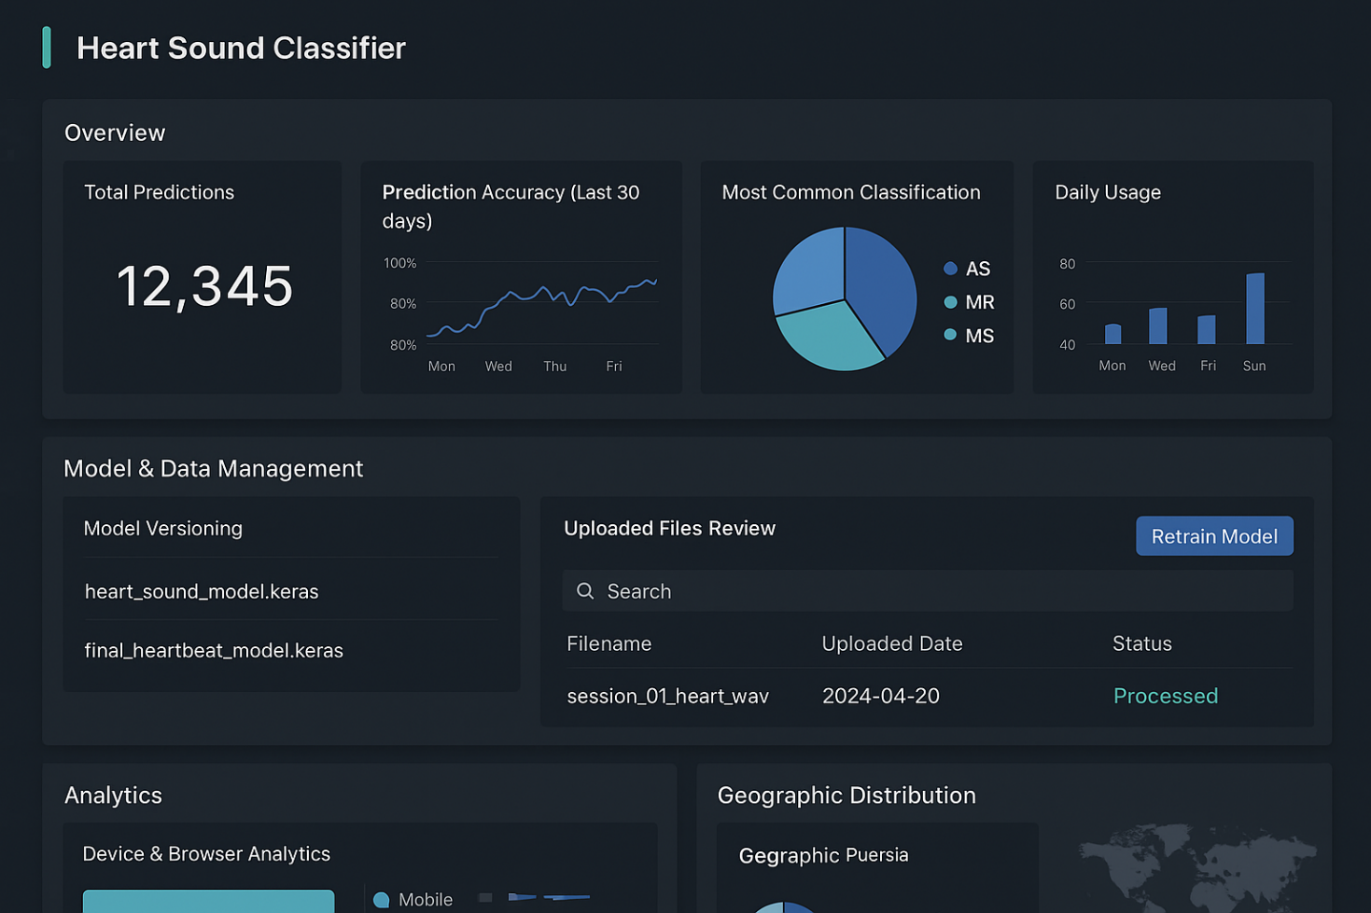
Admin-Side Interface

Slide 32
Part-09: Future Scope

Slide 33
Future Scope
Live Audio Input:
Implement real-time classification directly from a device's microphone, allowing for instant analysis without needing to upload a pre-recorded file.
Mobile App Development:
Port the application to a dedicated mobile platform (iOS/Android) to make the diagnostic tool even more accessible and portable for on-the-go use.
Database Integration:
Integrate with a database to securely store anonymized data, which could be used to continuously train and improve the model's accuracy over time.
Expanded Classifications:
Broaden the model's capabilities by training it on a larger, more diverse dataset to recognize a wider range of heart conditions and abnormalities.

Slide 34
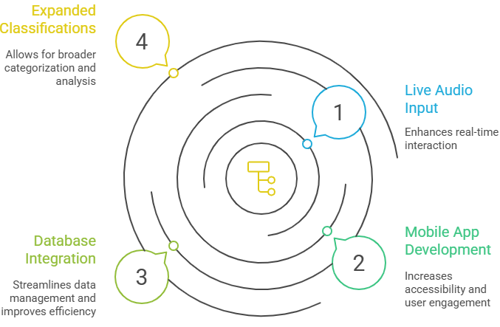
Future Scope

Slide 35


